Slide 1
RC_mid1
Yixuan Wang
2018/10/26

Slide 2
Before RC…
Checklist
Definition on the slides
Theorem on the slides, especially the condition of the theorem
Some questions on the slides, especially those with blue words
Assignment, especially the exercises with wrong answers
Worksheet

Slide 3
Content
Real Number and Sets
The limit of a sequence

Slide 4
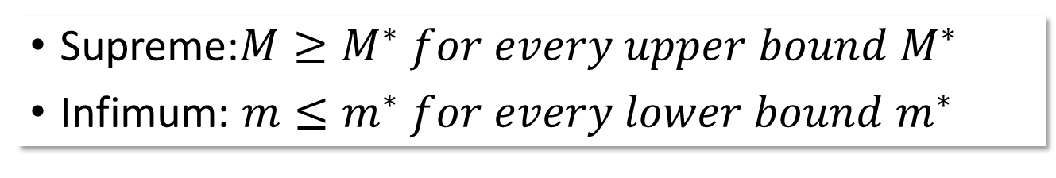
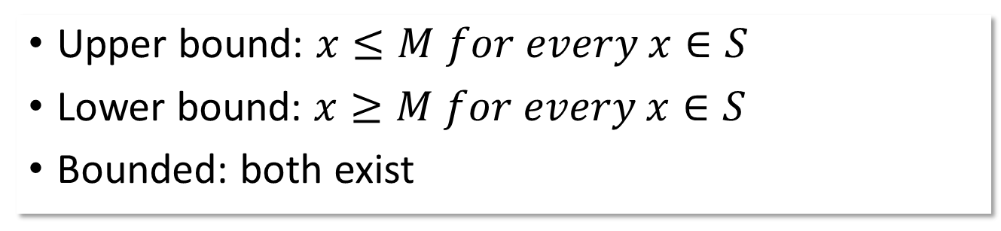
Real Number and Sets
Upper bound: $x≤M for every x∈S$
Lower bound: $x≥M for every x∈S$
Bounded: both exist
NOTE: upper bound and lower bound are numbers, but all of them consist of a set
Supreme:$M≥M^{∗} for every upper bound M^{∗}$
Infimum: $m≤m^{∗} for every lower bound m^{∗}$

Slide 5
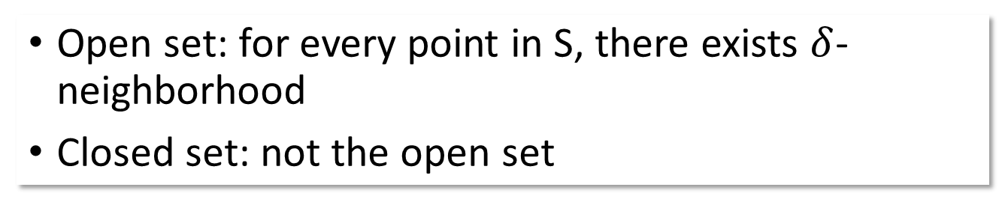
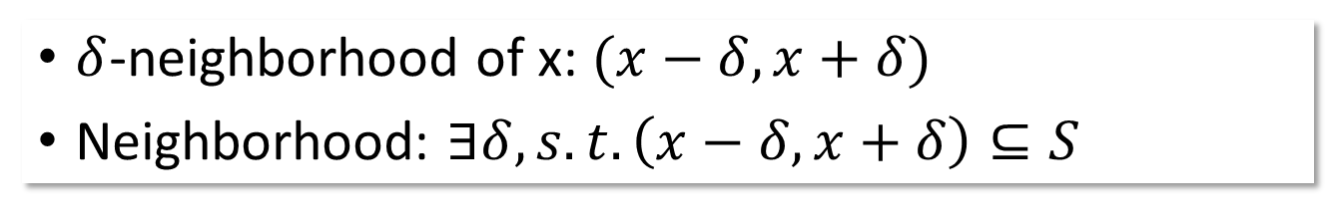
Real Number and Sets
$δ$-neighborhood of x: $(x−δ,x+δ)$
Neighborhood: $∃δ, s.t. \left(x−δ,x+δ\right)⊆S$
Open set: for every point in S, there exists $δ$-neighborhood
Closed set: not the open set
 | intersection | union
Closed set | Closed set | Inconclusive
Open set | Inconclusive | Open set

Slide 6
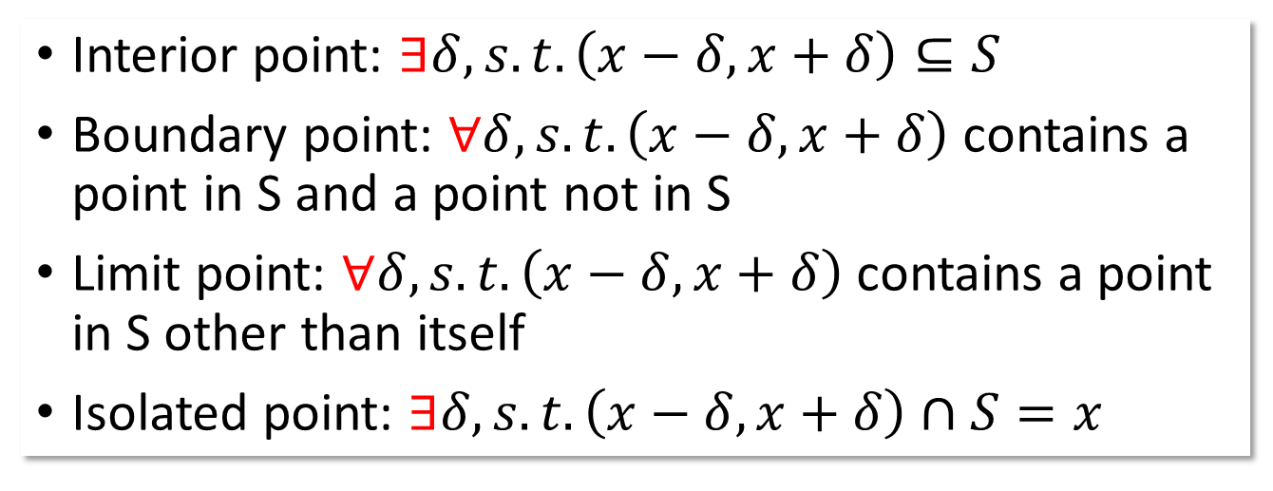
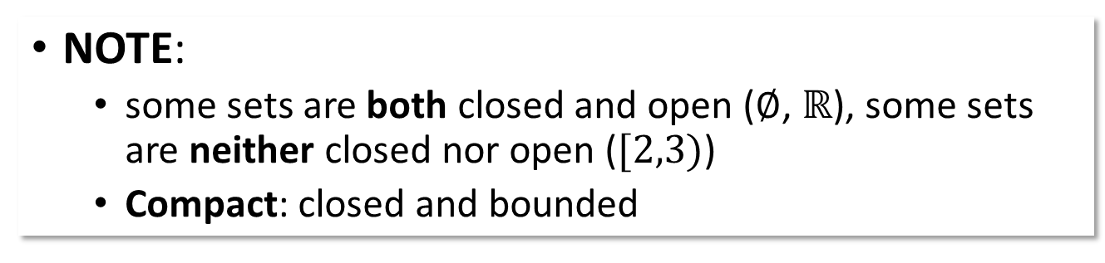
Real Number and Sets
NOTE:
some sets are both closed and open ($∅$, $ℝ$), some sets are neither closed nor open ($[2,3)$)
Compact: closed and bounded
Interior point: $∃δ, s.t. \left(x−δ,x+δ\right)⊆S$
Boundary point: $∀δ, s.t. \left(x−δ,x+δ\right)$ contains a point in S and a point not in S
Limit point: $∀δ, s.t. \left(x−δ,x+δ\right)$ contains a point in S other than itself
Isolated point: $∃δ, s.t. \left(x−δ, x+δ\right)∩S=x$

Slide 7
Real Number and Sets
Boundary Point
Interior Point
Limit Point
Isolated Point

Slide 8
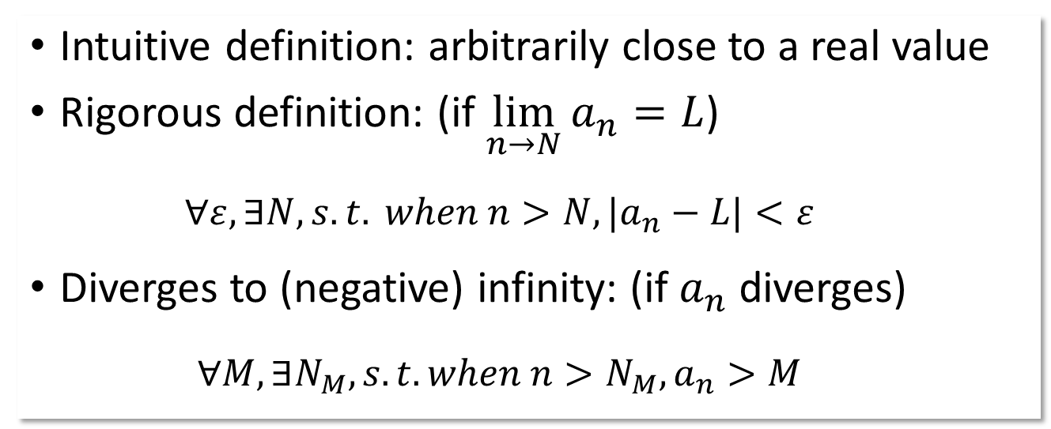
The limit of a sequence
Intuitive definition: arbitrarily close to a real value
Rigorous definition: (if $\lim_{n→N}{a_{n}}=L$)
$$∀ε, ∃N, s.t. when n>N, {|a}_{n}−L|<ε$$
Diverges to (negative) infinity: (if $a_{n}$ diverges)
$$∀M, ∃N_{M}, s.t. when n>N_{M}, a_{n}>M$$

Slide 9
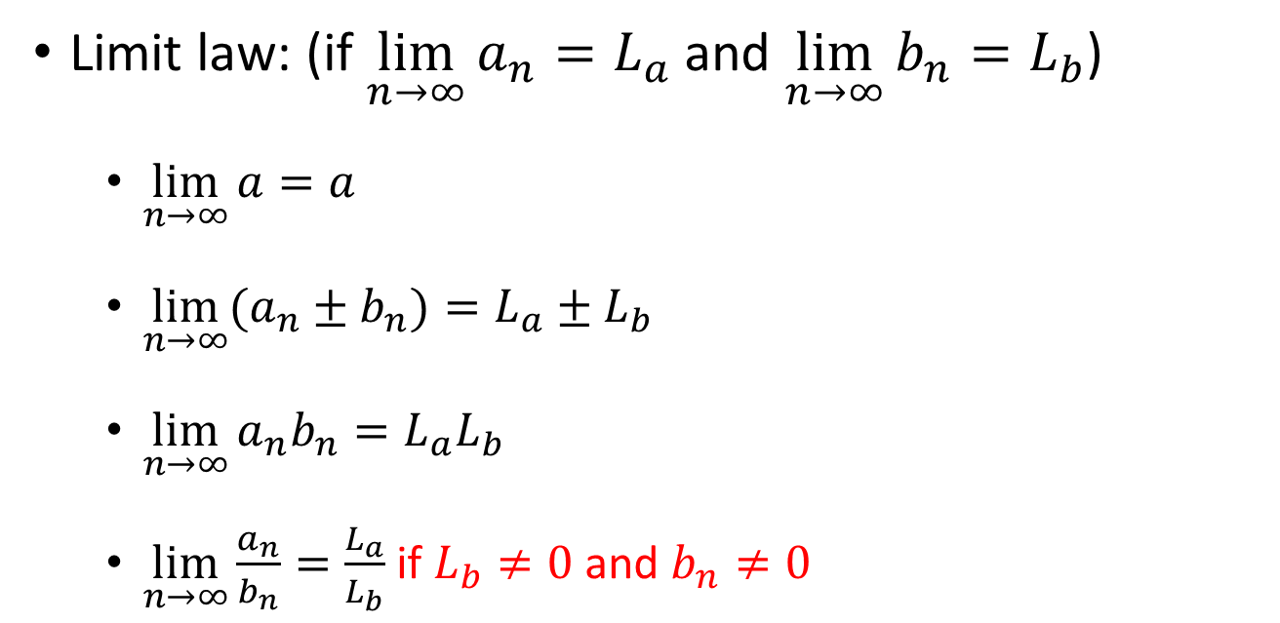
The limit of a sequence
Limit law: (if $\lim_{n→∞}{a_{n}}=L_{a}$ and $\lim_{n→∞}{b_{n}}=L_{b}$)
$\lim_{n→∞}{a}=a$
$\lim_{n→∞}{(a_{n}±b_{n}})=L_{a}±L_{b}$
$\lim_{n→∞}{a_{n}b_{n}}=L_{a}L_{b}$
$\lim_{n→∞}{\frac{a_{n}}{b_{n}}}=\frac{L_{a}}{L_{b}}$ if $L_{b}≠0$ and $b_{n}≠0$

Slide 10
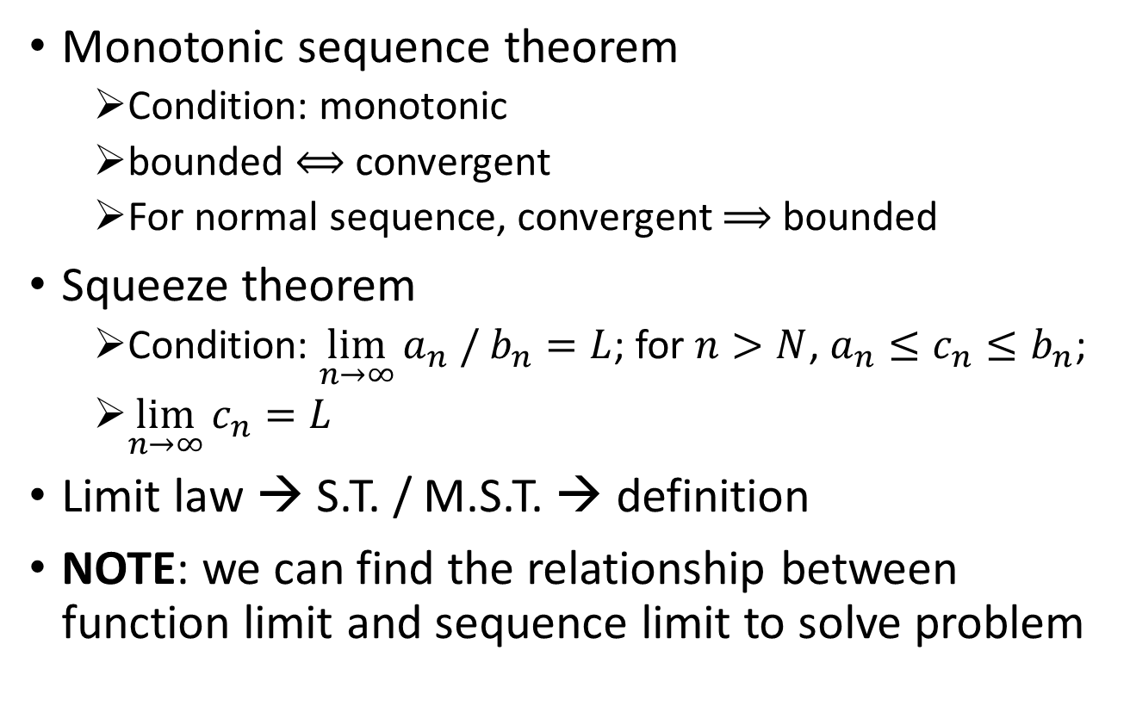
The limit of a sequence
Monotonic sequence theorem
Condition: monotonic
bounded $⟺$ convergent
For normal sequence, convergent $⟹$ bounded
Squeeze theorem
Condition: $\lim_{n→∞}{a_{n} / b_{n}}=L$; for $n>N$, $a_{n}≤c_{n}≤b_{n}$;
$\lim_{n→∞}{c_{n}}=L$
Limit law → S.T. / M.S.T. → definition
NOTE: we can find the relationship between function limit and sequence limit to solve problem

Slide 11
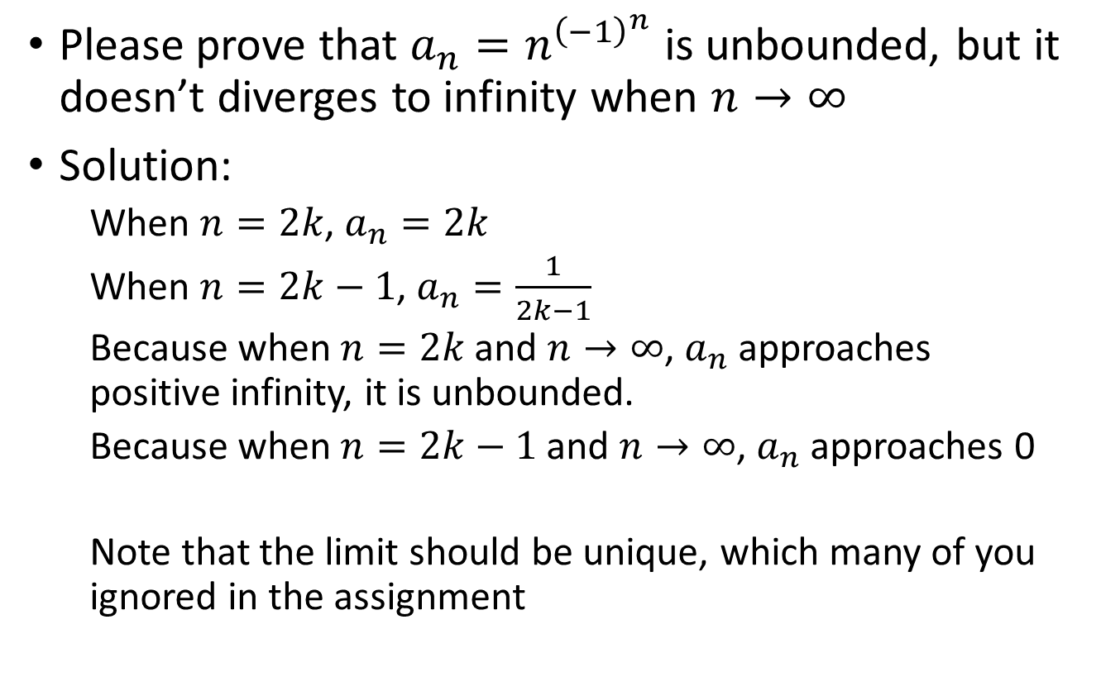
Exercise
Please prove that $a_{n}=n^{{\left(−1\right)}^{n}}$ is unbounded, but it doesn’t diverges to infinity when $n→∞$
Solution:
When $n=2k$, $a_{n}=2k$
When $n=2k−1$, $a_{n}=\frac{1}{2k−1}$
Because when $n=2k$ and $n→∞$, $a_{n}$ approaches positive infinity, it is unbounded.
Because when $n=2k−1$ and $n→∞$, $a_{n}$ approaches 0
Note that the limit should be unique, which many of you ignored in the assignment

Slide 12

Exercise
Please prove $\lim_{n→∞}{\frac{n}{2^{n}}}=0$
Solution:
Because $2^{n}={\left(1+1\right)}^{n}=1+n+\frac{n(n−1)}{2}+…+1>\frac{n(n−1)}{2}$
Then use the Squeeze Theorem

Slide 13
Good Luck!

